Slide 1
Week 6
Doing a DIVISION in Tuple Relational Calculus

Slide 2
Student Objectives
Upon completion of this video, you should be able to:
Understand the tuple relational calculus statement that will answer the query using DIVISION

Slide 3
In Relational Algebra, we have this: CC ← AA ÷ BB
Table AA:
Table BB:
A | B
a1 | b1
a2 | b1
a3 | b1
a4 | b1
a1 | b2
a3 | b2
a2 | b3
a3 | b3
a4 | b3
a1 | b4
a2 | b4
a3 | b4
A
a1
a2
a3
HOW DO WE SHOW THIS IN RELATIONAL CALCULUS?
Table CC:
B
b1
b4
{e.B | AA(e) AND ((∀x)((NOT (BB(x)) OR (e.A=x.A)))}

Slide 4
We will be using the following tables for our discussion and examples:
Employee
FName | Minit | Lname | SSN | BDate | Address | Sex | Salary | SuperSSN* | DNO*
Department
DName | DNumber | MGRSSN* | MgrStartDate
Works_On
DepartmentLocation
ESSN* | PNO* | Hours
Dnumber* | Dlocation
Project
PName | PNumber | Plocation | Dnum*
Dependent
ESSN* | DependentName | Sex | BDate | Relationship

Slide 5
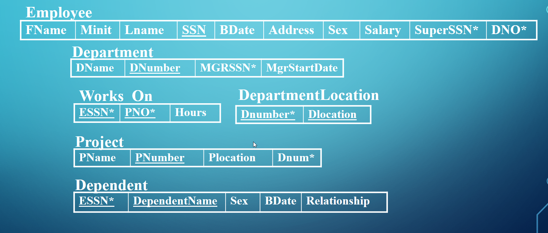
Question: Write the query to find the names of all employees who work on ALL the projects controlled by department number 5.
{e.Firstname, e.Lastname | EMPLOYEE(e) AND ((∀x)(NOT (PROJECT(x)) or (NOT (x.DNUM = 5) or ((∃w) (WORKSON(w) and w.ESSN = e.SSN and x.PNUMBER= w.PNO)))))}

Slide 6
Similar to Division in Relational Algebra
Consider: Suppose we have an employee who doesn't work on one of the projects controlled by department 5 (Let's say there are 4 projects controlled by department 5 and he only works on 3 of them). We will look at that last project that he doesn't work on:
x, a tuple from the project table, which is controlled by dept 5, will be in the project table so NOT(PROJECT(x)) = FALSE
have a DNUM=5 so NOT(x.DNUM=5) = FALSE
but there will not exist a w in the WORKSON table where w.PNO = x.PNUMBER and w.ESSN=e.SSN so that will be FALSE
thus we have (F or F or F) = FALSE and the FORALL x is now F because there is one x that it is false for, thus it is not true for all x
{e.Firstname, e.Lastname | EMPLOYEE(e) AND ((∀x)(NOT (PROJECT(x)) or (NOT (x.DNUM = 5) or ((∃w) (WORKSON(w) and w.ESSN = e.SSN and x.PNUMBER= w.PNO)))))}

Slide 7
2. If we assume that x is not in the PROJECT table then for all x, the predicate would be true (so display all employees since there are no projects, you could say all the employees work on all the projects controlled by dept 5 since there are 0 projects and everyone works on 0 projects), but there must be some project tuples so it is FALSE
we will assume that x is in the PROJECT table but let’s also assume, none of the tuples = 5 then since there are no projects controlled by department 5 you could say all the employees work on all the projects controlled by dept 5 since there are 0 projects and everyone works on 0 projects), if there are some projects that are project 5, then NOT(x.DNUM=5) is false
let’s assume that x is all the tuples that are in the project table and are 5, there must exist a corresponding workson tuple for every one of the x tuples for this to be true
{e.Firstname, e.Lastname | EMPLOYEE(e) AND ((∀x)(NOT (PROJECT(x)) or (NOT (x.DNUM = 5) or ((∃w) (WORKSON(w) and w.ESSN = e.SSN and x.PNUMBER= w.PNO)))))}

